Slide 1


Exploratory Data Analysis
Introduction to data science ----- 03-11-2020
Aneesa Abbasi
PDEng – Data Science

Slide 2
Agenda
What is not EDA?
What is EDA?
Why do we need EDA?
When do we need EDA?
Types of EDA with examples?
Benefits EDA brings to Machine learning projects

Slide 3

What do you think Exploratory Data Analysis is?

Slide 4



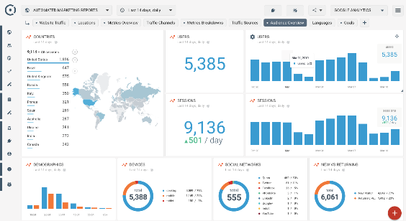
EDA?????.....
Hypothesis verification
Example: Almost half of the population will get corona virus in the world
- Yes? No?
Modelling the data with appropriate model
Example: Using logistic regression to predict increase in house prices
Serving the ML algorithm on cloud technology
Example: Google cloud
Building a data product
Example: Dashboard
Notes:
Ronald Coase said “Torture the data, and it will confess to Anything”.

Slide 5
Definition-s of EDA
Tukey defined data analysis in 1961 as: "Procedures for analyzing data, techniques for interpreting the results of such procedures, ways of planning the gathering of data to make its analysis easier, more precise or more accurate, and all the machinery and results of (mathematical) statistics which apply to analyzing data."
Exploratory Data Analysis (EDA) is an approach/philosophy for data analysis that employs a variety of techniques (mostly graphical) to maximize insight into a data set;
uncover underlying structure; extract important variables; detect outliers and anomalies; test underlying assumptions; and determine optimal factor settings.
Data Analysis is basically where you use statistics and probability to figure out trends in data set. It helps you to sort out the “real” trends from the statistical noise.
Notes:
Ronald Coase said “Torture the data, and it will confess to Anything”.

Slide 6
What is EDA?
Have an understanding of the data outcome
Communicate data outcome to clients
Maximizing the insights in the dataset
Figure out trends and visualize them
Useful for data scientists
Let the data speak to you…………
Notes:
Ronald Coase said “Torture the data, and it will confess to Anything”.

Slide 7

Why do we need EDA?
Trust the data to speak for itself.
The “Doubtititis” Syndrome
Notes:
Ronald Coase said “Torture the data, and it will confess to Anything”.

Slide 8

Why EDA is important for Data Scientists?

Slide 9
Tools & Techniques for EDA
Univariate non graphical methods
Univariate graphical methods
Multivariate non graphical methods
Multivariate graphical methods
Notes:
Ronald Coase said “Torture the data, and it will confess to Anything”.

Slide 10
1. Univariate non graphical methods
Most useful for sample distribution kind of analysis
Perfect for outlier detection
Data types which are best for this are categorical and quantitative data
Examples, mean , mode, measure of spread, measure of skewness
Notes:
Ronald Coase said “Torture the data, and it will confess to Anything”.

Slide 11
2. Univariate graphical methods
Useful for data visualization of single variable
Perfect for visualizing the categorical data and graphical representation of outliers
Examples are bar plots, stem plots, box plots and stem and leaf plots, histograms
Notes:
Ronald Coase said “Torture the data, and it will confess to Anything”.

Slide 12
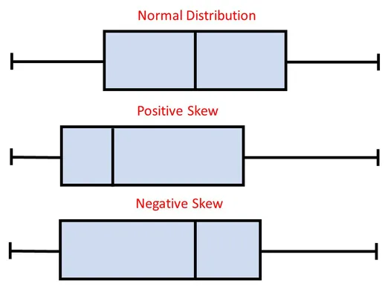
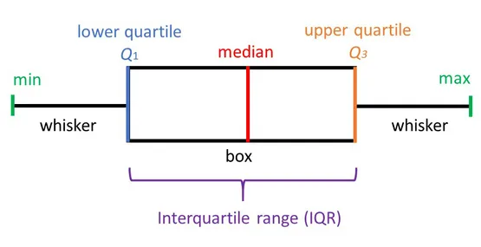
Example: Box plot
Distribution of numerical data and skewness through displaying the data quartiles (or percentiles) and averages.
Notes:
Ronald Coase said “Torture the data, and it will confess to Anything”.

Slide 13
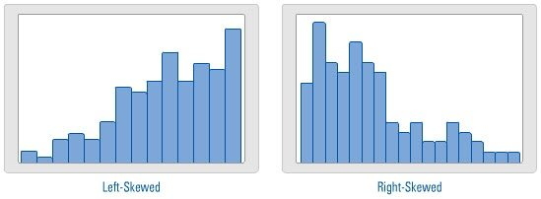
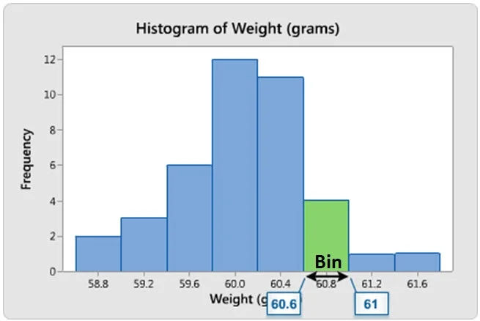
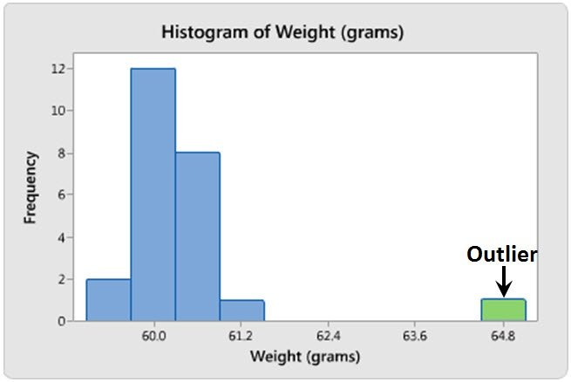
Example: Histograms
In statistics, a histogram is representation of the distribution of numerical data, where the data are binned and the count for each bin is represented.
Notes:
Ronald Coase said “Torture the data, and it will confess to Anything”.

Slide 14
3. Multivariate non graphical methods
Multivariate non graphical methods shows the relationship between two or more variables in the form of cross tabulation or statistics
Examples are correlation and covariance matrix
Notes:
Ronald Coase said “Torture the data, and it will confess to Anything”.

Slide 15
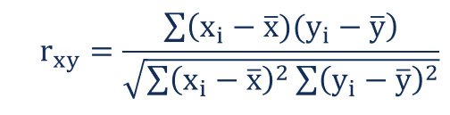
Example: Correlations
Correlation is a statistical technique that can show whether and how strongly pairs of variables are related.
Where:
r_{xy} – the correlation coefficient of the linear relationship between the variables x and y
x_{i} – the values of the x-variable in a sample
x̅ – the mean of the values of the x-variable
y_{i} – the values of the y-variable in a sample
ȳ – the mean of the values of the y-variable
Notes:
Ronald Coase said “Torture the data, and it will confess to Anything”.

Slide 16
4. Multivariate graphical methods
Useful for comparing two or more variables graphically.
Perfect for analyzing and detecting clusters and patterns in the data
Examples are scatter plots, side by side univariate box plots, violin plots etc
Notes:
Ronald Coase said “Torture the data, and it will confess to Anything”.

Slide 17
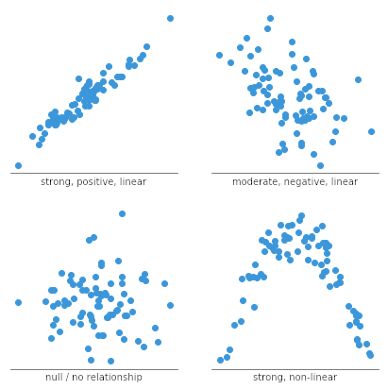
Example : Scatter plot
Scatter plots’ primary uses are to observe and show relationships between two numeric variables. The dots in a scatter plot not only report the values of individual data points, but also patterns when the data are taken as a whole.
Notes:
Ronald Coase said “Torture the data, and it will confess to Anything”.

Slide 18
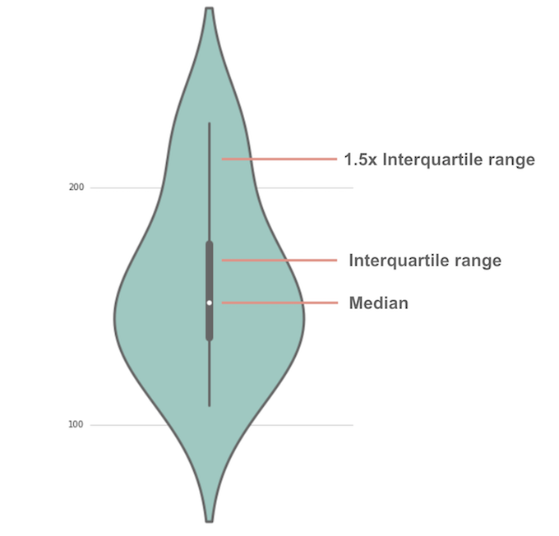
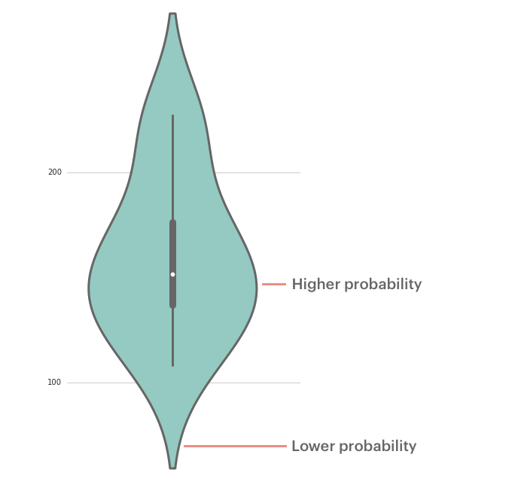
Example: Violin plot
A violin plot is a method of plotting numeric data. Violin plots are similar to box plots, except that they also show the probability density of the data at different values, usually smoothed by a kernel density estimator.
Notes:
Ronald Coase said “Torture the data, and it will confess to Anything”.

Slide 19

Example: word clouds
Notes:
Ronald Coase said “Torture the data, and it will confess to Anything”.

Slide 20
5. Benefits EDA brigs to machine learning projects
The right context
Result interpretation
Identifying feature distribution
Feature engineering

Slide 21

Me when anyone tries to skip the EDA from the process of a ML project……

Slide 22
Key takeaways..
To master the art of data analysis you need to be a good story teller and EDA helps you achieve that.
Feature Engineering is difficult without proper EDA
Model selection easier and faster when you let the data speak for itself…..

